Slide 1
Chapter 14: More About Classes

Slide 2
14.1
Instance and Static Members

Slide 3
Instance and Static Members
instance variable: a member variable in a class. Each object has its own copy.
static variable: one variable shared among all objects of a class
static member function: can be used to access static member variable; can be called before any objects are defined

Slide 4
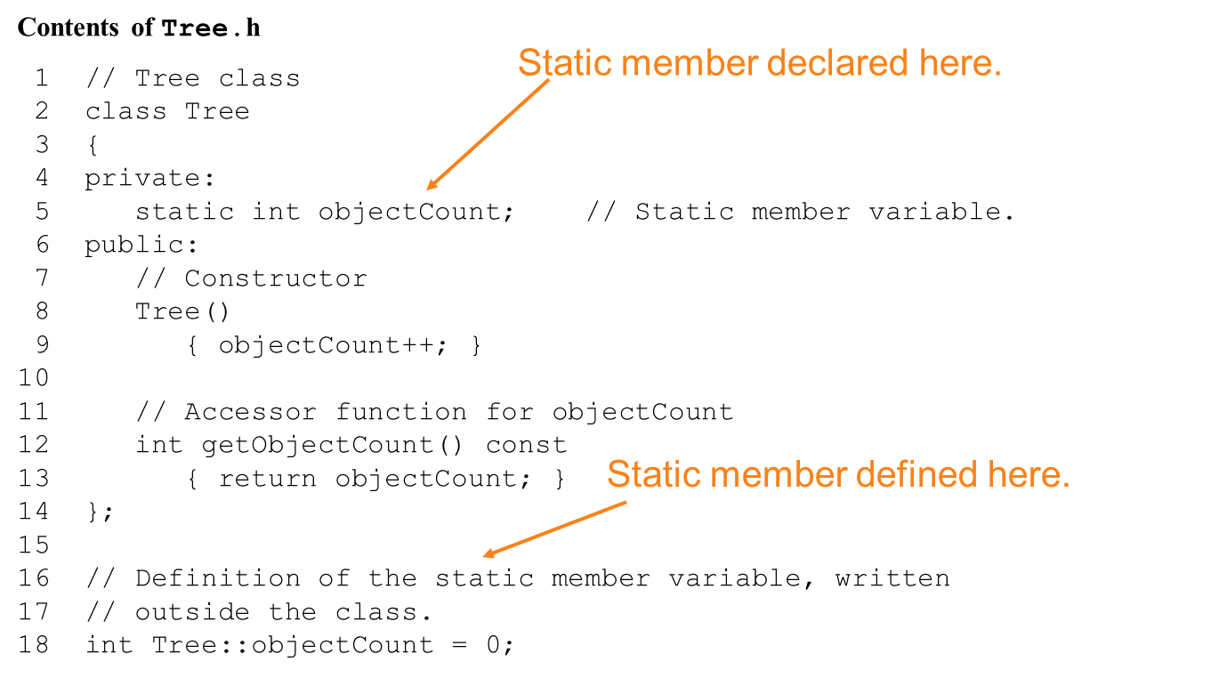
static member variable

Slide 5
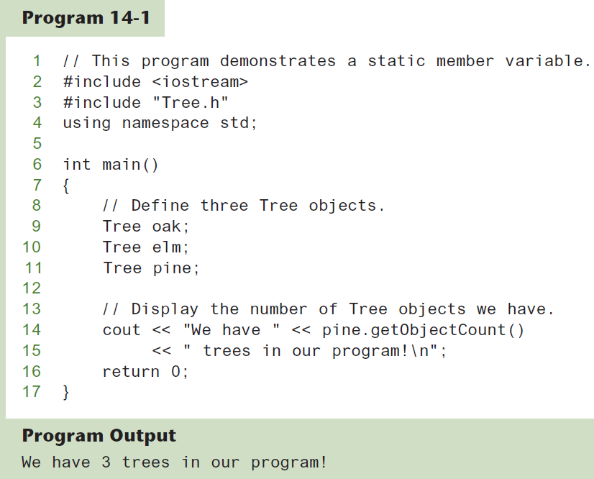

Slide 6
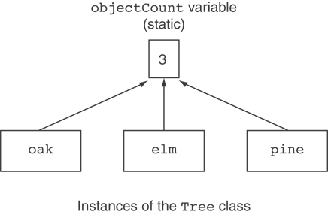
Three Instances of the Tree Class, But Only One objectCount Variable

Slide 7
static member function
Declared with static before return type:
static int getObjectCount() const
{ return objectCount; }
Static member functions can only access static member data
Can be called independent of objects:
int num = Tree::getObjectCount();

Slide 8
Modified Version of Tree.h
1 // Tree class 2 class Tree 3 { 4 private: 5 static int objectCount; // Static member variable. 6 public: 7 // Constructor 8 Tree() 9 { objectCount++; } 10 11 // Accessor function for objectCount 12 static int getObjectCount() const 13 { return objectCount; } 14 }; 15 16 // Definition of the static member variable, written 17 // outside the class. 18 int Tree::objectCount = 0;
Now we can call the function like this: cout << "There are " << Tree::getObjectCount()
<< " objects.\n";

Slide 9
14.2
Friends of Classes

Slide 10
Friends of Classes
Friend: a function or class that is not a member of a class, but has access to private members of the class
A friend function can be a stand-alone function or a member function of another class
It is declared a friend of a class with friend keyword in the function prototype

Slide 11
friend Function Declarations
Stand-alone function:
friend void setAVal(intVal&, int);
// declares setAVal function to be
// a friend of this class
Member function of another class:
friend void SomeClass::setNum(int num)
// setNum function from SomeClass
// class is a friend of this class

Slide 12
friend Class Declarations
Class as a friend of a class:
class FriendClass
{
...
};
class NewClass
{
public:
friend class FriendClass; // declares
// entire class FriendClass as a friend
// of this class
…
};

Slide 13
14.3
Memberwise Assignment

Slide 14
Memberwise Assignment
Can use = to assign one object to another, or to initialize an object with an object’s data
Copies member to member. e.g.,
instance2 = instance1; means:
copy all member values from instance1 and assign to the corresponding member variables of instance2
Use at initialization:
Rectangle r2 = r1;

Slide 15
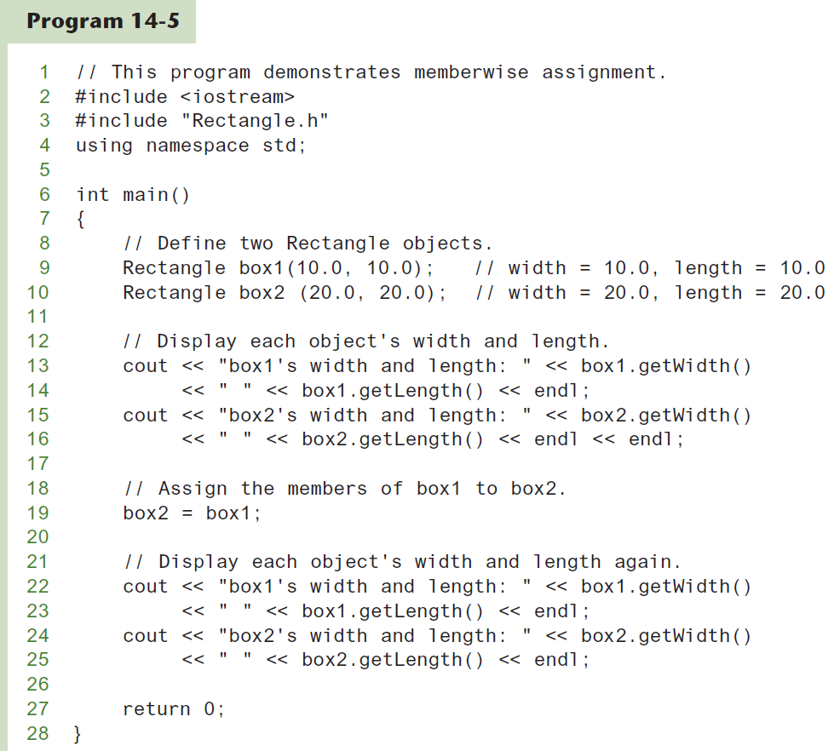

Slide 16
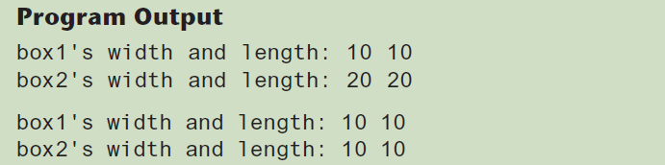

Slide 17
14.4
Copy Constructors

Slide 18
Copy Constructors (1 of 3)
Special constructor used when a newly created object is initialized to the data of another object of same class
Default copy constructor copies field-to-field
Default copy constructor works fine in many cases

Slide 19
Copy Constructors (2 of 3)
Problem: what if object contains a pointer?
class SomeClass
{ public:
SomeClass(int val = 0)
{value=new int; *value = val;}
int getVal();
void setVal(int);
private:
int *value;
}

Slide 20
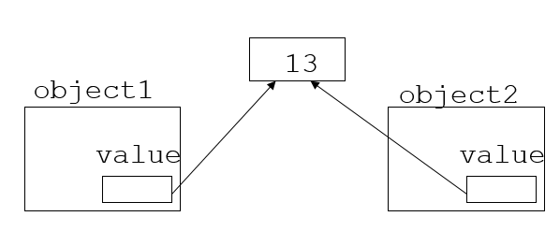
Copy Constructors (3 of 3)
What we get using memberwise copy with
objects containing dynamic memory:
SomeClass object1(5);
SomeClass object2 = object1;
object2.setVal(13);
cout << object1.getVal(); // also 13

Slide 21
Programmer-Defined Copy Constructor (1 of 3)
Allows us to solve problem with objects containing pointers:
SomeClass::SomeClass(const SomeClass &obj)
{
value = new int;
*value = obj.value;
}
Copy constructor takes a reference parameter to an object of the class

Slide 22
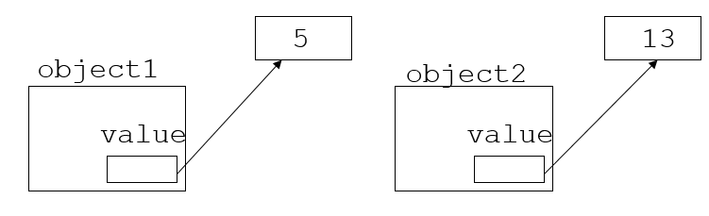
Programmer-Defined Copy Constructor (2 of 3)
Each object now points to separate dynamic memory:
SomeClass object1(5);
SomeClass object2 = object1;
object2.setVal(13);
cout << object1.getVal(); // still 5

Slide 23
Programmer-Defined Copy Constructor (3 of 3)
Since copy constructor has a reference to the object it is copying from,
SomeClass::SomeClass(SomeClass &obj)
it can modify that object.
To prevent this from happening, make the object parameter const:
SomeClass::SomeClass
(const SomeClass &obj)

Slide 24
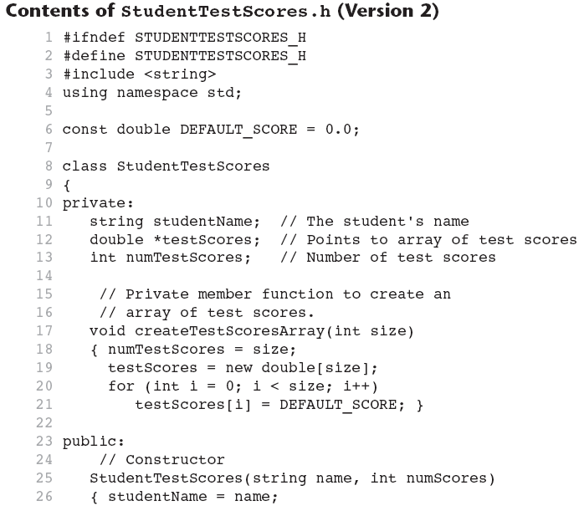

Slide 25
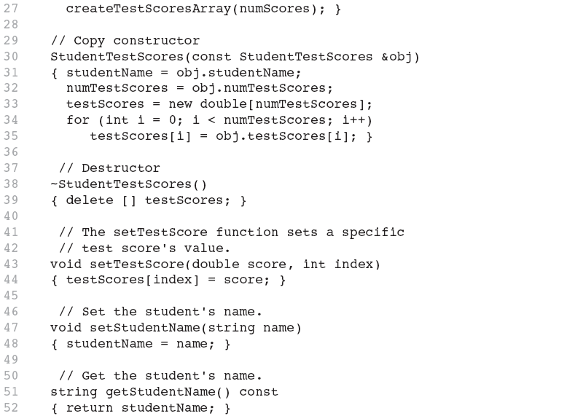

Slide 26
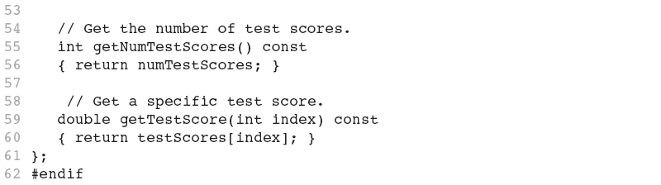

Slide 27
14.5
Operator Overloading

Slide 28
Operator Overloading (1 of 2)
Operators such as =, +, and others can be redefined when used with objects of a class
The name of the function for the overloaded operator is operator followed by the operator symbol, e.g.,
operator+ to overload the + operator, and
operator= to overload the = operator
Prototype for the overloaded operator goes in the declaration of the class that is overloading it
Overloaded operator function definition goes with other member functions

Slide 29
The this Pointer (1 of 3)
this: predefined pointer available to a class’s member functions
Always points to the instance (object) of the class whose function is being called
Is passed as a hidden argument to all non-static member functions

Slide 30
The this Pointer (2 of 3)
Example, student1 and student2 are both StudentTestScores objects.
The following statement causes the getStudentName member function to operate on student1:
cout << student1.getStudentName() << endl;
When getStudentName is operating on student1, the this pointer is pointing to student1.

Slide 31
The this Pointer (3 of 3)
Likewise, the following statement causes the getStudentName member function to operate on student2:
cout << student2.getStudentName() << endl;
When getStudentName is operating on student2, the this pointer is pointing to student2.
The this pointer always points to the object that is being used to call the member function.

Slide 32
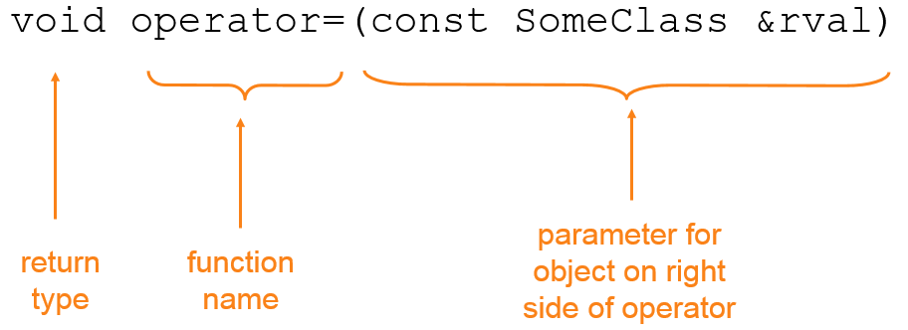
Operator Overloading (2 of 2)
Prototype:
Operator is called via object on left side

Slide 33
Invoking an Overloaded Operator
Operator can be invoked as a member function:
object1.operator=(object2);
It can also be used in more conventional manner:
object1 = object2;

Slide 34
Returning a Value (1 of 2)
Overloaded operator can return a value
class Point2d
{
private:
int x, y;
...
public:
double operator-(const point2d &right)
{ return sqrt(pow((x-right.x),2)
+ pow((y-right.y),2)); }
};
Point2d point1(2,2), point2(4,4);
// Compute and display distance between 2 points.
cout << point2 – point1 << endl; // displays 2.82843

Slide 35
Returning a Value (2 of 2)
Return type the same as the left operand supports notation like:
object1 = object2 = object3;
Function declared as follows:
const SomeClass operator=(const someClass &rval)
In function, include as last statement:
return *this;

Slide 36
Notes on Overloaded Operators
Can change meaning of an operator
Cannot change the number of operands of the operator
Only certain operators can be overloaded. Cannot overload the following operators:
?: . .* :: sizeof

Slide 37
Overloading Types of Operators
++, −− operators overloaded differently for prefix vs. postfix notation
Overloaded relational operators should return a bool value
Overloaded stream operators >>, << must return reference to istream, ostream objects and take istream, ostream objects as parameters

Slide 38
Overloaded [] Operator
Can create classes that behave like arrays, provide bounds-checking on subscripts
Must consider constructor, destructor
Overloaded [] returns a reference to object, not an object itself

Slide 39
14.6
Object Conversion

Slide 40
Object Conversion
Type of an object can be converted to another type
Automatically done for built-in data types
Must write an operator function to perform conversion
To convert an FeetInches object to an int:
FeetInches::operator int()
{return feet;}
Assuming distance is a FeetInches object, allows statements like:
int d = distance;

Slide 41
14.7
Aggregation

Slide 42
Aggregation (1 of 2)
Aggregation: a class is a member of a class
Supports the modeling of ‘has a’ relationship between classes – enclosing class ‘has a’ enclosed class
Same notation as for structures within structures

Slide 43
Aggregation
class StudentInfo
{
private:
string firstName, LastName;
string address, city, state, zip;
...
};
class Student
{
private:
StudentInfo personalData;
...
};

Slide 44
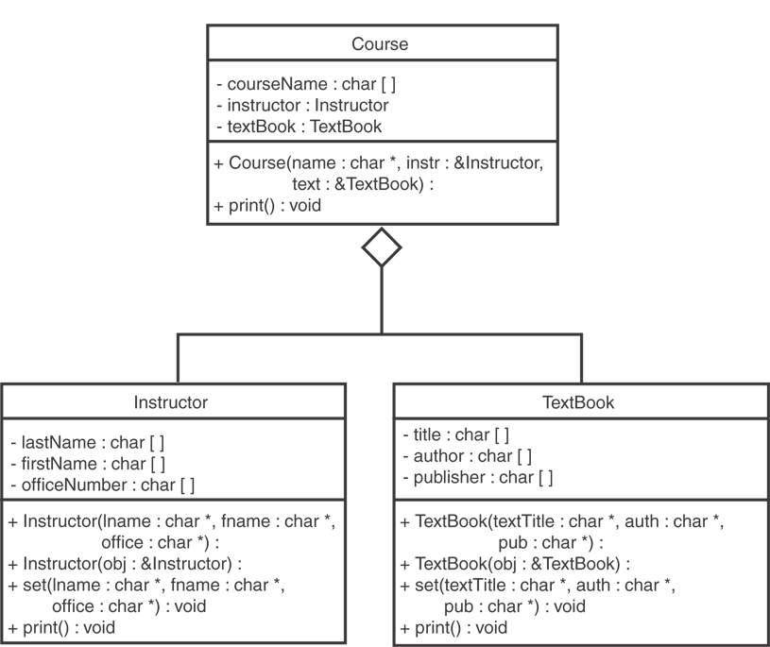
See the Instructor, TextBook, and Course classes in Chapter 14.

Slide 45
14.10
Rvalue References and Move Semantics

Slide 46
Temporary Values (1 of 2)
Consider this code:
int x;
x = 2 * 6;
When the expression 2 * 6 is evaluated, the value 12 is stored in memory as a temporary value.
The temporary value is then stored in the x variable.
Then, the temporary value is discarded.

Slide 47
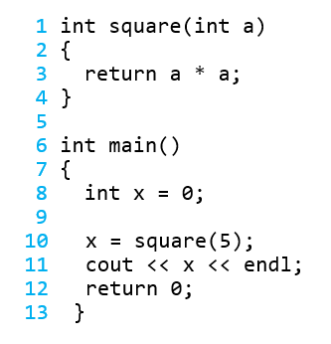
Temporary Values (2 of 2)
Consider this:
The square function is called, and the value 5 is passed as an argument.
The square function calculates 5 * 5 and stores the result, 25, as a temporary value.
The temporary value is copied (assigned) to the variable x.
The temporary value is no longer needed, so the system discards it.

Slide 48
Lvalues and Rvalues
Two types of values stored in memory during the execution of a program:
Values that persist beyond the statement that created them and have names that make them accessible to other statements in the program. In C++, these values are called lvalues.
Values that are temporary and cannot be accessed beyond the statement that created them. In C++, these values are called rvalues.

Slide 49
Rvalue References
Rvalue Reference: a reference variable that can refer only to temporary objects that would otherwise have no name.
Rvalue references are used to write move constructors and move assignment operators (otherwise known as move semantics).
Anytime you write a class with a pointer or reference to a piece of data outside the class, you should implement move semantics.
Move semantics increase the performance of these types of classes.

Slide 50
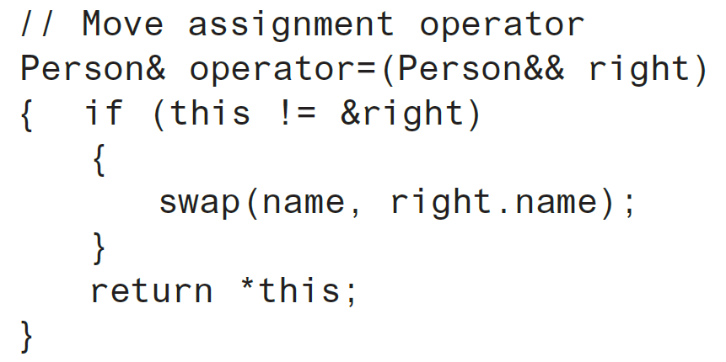
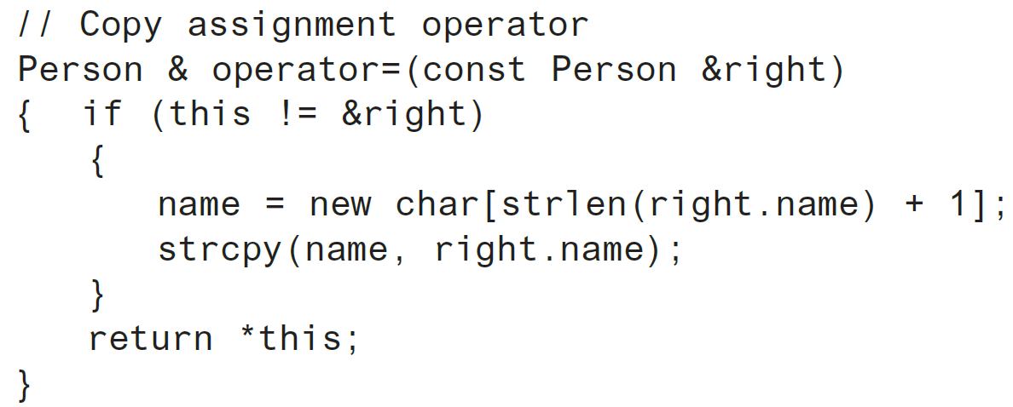
Move Assignment vs. Copy Assignment
From the Person class, in Chapter 14:

Slide 51
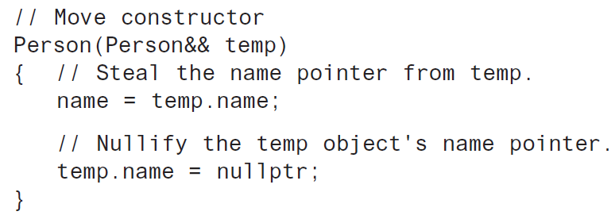
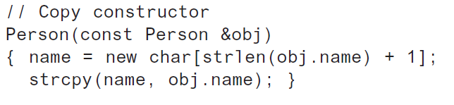
Move Constructor vs. Copy Constructor
From the Person class, in Chapter 14:

Slide 52
When to Implement Move Semantics
In any class that contains a pointer or reference to an outside piece of data, the class should also have:
copy constructor
move constructor
copy assignment operator
move assignment operator

Slide 53
Default Operations (1 of 2)
Consider this class:
The compiler will automatically generate:
A default constructor MyClass()
A copy constructor MyClass(const MyClass &)
A copy assignment operator MyClass & operator=(const Myclass &)
A move constructor MyClass(MyClass &&)
A destructor ~MyClass()
class MyClass
{
private:
int mydata = 0;
public:
int getMyData()
{ return mydata; }
void setMyData(int d)
{ mydata = d; }
};

Slide 54
Default Operations (2 of 2)
If you write any of these in a class, the compiler will not provide any default versions of these functions:
Default constructor
Copy constructor
Copy Assignment Operator
Move Constructor
Destructor

Slide 55
The default Key Word (1 of 2)
You can use the default keyword to declare which default operations that you want the compiler to automatically provide

Slide 56
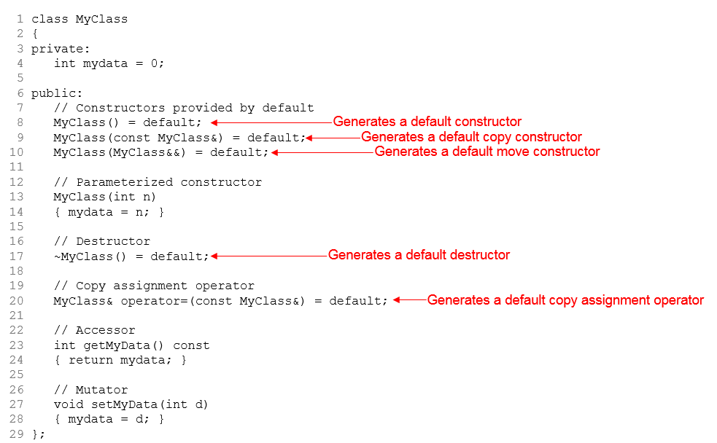
The default Key Word (2 of 2)

Slide 57
The delete Key Word (1 of 2)
You can use the delete keyword to declare which default operations you do not want the compiler to automatically provide

Slide 58
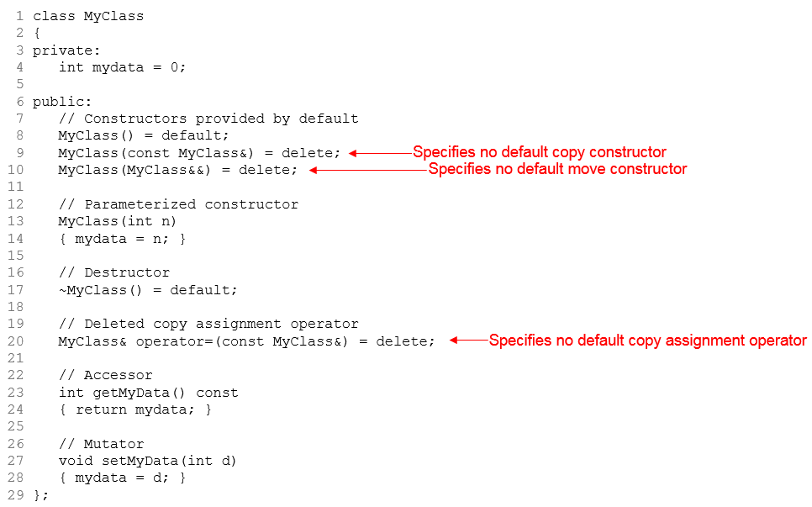
The delete Key Word (2 of 2)
As a result of these declarations, MyClass objects cannot be copied by a constructor or by an assignment operation.

